Slide 1
ARIMA Chapter 8 Review Forecasting: Principles and Practice Hyndman, Rob J., and George Athanasopoulos
Christophe Hunt

Slide 2
AR I MA
Auto Regressive – Integrated – Moving Average
p d q
[AR Model] + [Differencing to reach Stationarity] + [MA Model]

Slide 3
Integrated
Stationarity
Differencing
Unit Root Test
Backshift Notation

Slide 4
Stationarity
Stationarity = no predictable pattern in the long-term and statistical properties remain the same
Stationarity ≠ Trend
Stationarity ≠ Seasonality
Stationarity = Cyclical (because we do not know when mountains and valleys will occur)
If we have trends or seasonality we can make the time series stationary by computing the differences between consecutive observations which is called differencing.
Notes:
Stationarity means that the statistical prosperities remain the same

Slide 5
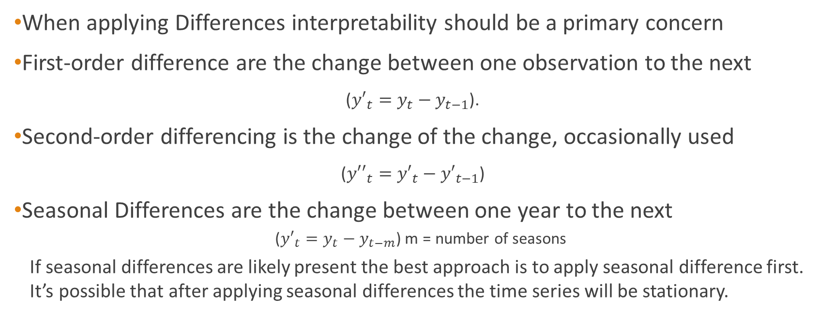
Differencing
When applying Differences interpretability should be a primary concern
First-order difference are the change between one observation to the next
(${y′}_{t}=y_{t}−y_{t−1}$).
Second-order differencing is the change of the change, occasionally used
(${y′′}_{t}={y′}_{t}−{y′}_{t−1}$)
Seasonal Differences are the change between one year to the next
(${y′}_{t}=y_{t}−y_{t−m}$) m = number of seasons
If seasonal differences are likely present the best approach is to apply seasonal difference first. It’s possible that after applying seasonal differences the time series will be stationary.

Slide 6
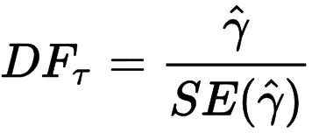
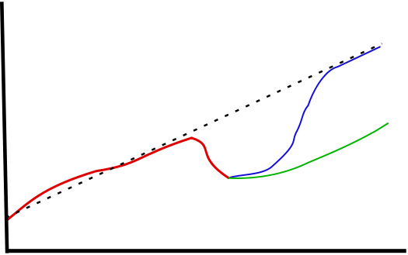

Unit root tests
Augmented Dickey-Fuller (ADF) test =
The null-hypothesis for an ADF test is that the variable contains a unit and the data is non-stationary.
Large p-values are indicative of non-stationarity, and small p-values suggest stationarity
Kwiatkowski-Phillips-Schmidt-Shin (KPSS) test =
The null-hypothesis is that the data is stationary.
Small p-values suggest that differencing is required.
The diagram above depicts an example of a potential unit root. The red line represents an observed drop in output. Green shows the path of recovery if the series has a unit root. Blue shows the recovery if there is no unit root and the series is trend-stationary.
By Bkwillwm - Own work, CC BY-SA 3.0, https://commons.wikimedia.org/w/index.php?curid=9425029
"Y." KPSS Test for Stationarity - MATLAB Kpsstest. Web. 01 Oct. 2017.

Slide 7
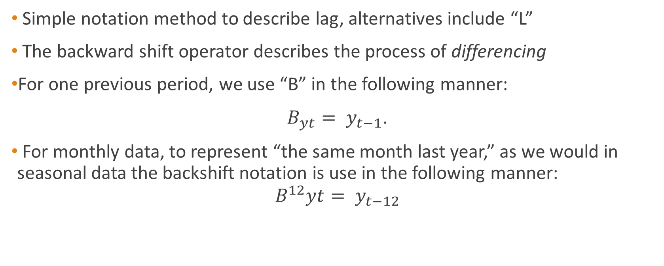
Backshift notation
Simple notation method to describe lag, alternatives include “L”
The backward shift operator describes the process of differencing
For one previous period, we use “B” in the following manner:
${B_{yt}= y}_{t−1}$.
For monthly data, to represent “the same month last year,” as we would in seasonal data the backshift notation is use in the following manner:
$${B^{12}yt= y}_{t−12}$$

Slide 8
ACF and PACF Plots
The coefficient of correlation between two observations is the autocorrelation function (ACF) and when plotted can be useful to detect non-stationary time series
The ACF plot and partial autocorrelations (PACF) plot are also used to identify the number of AR and/or MA terms.
The order of AR(p) can be determined when the ACF plot is exponentially decaying and significant spike at lag p in PACF, but none beyond lag p
The order of MA(q) can be determined when the PACF is exponentially decaying and there is a significant spike at lag q in ACF, but none beyond lag q
Notes:
Further explain ACF and PACF

Slide 9

Auto Regressive Models
Auto Regressive Model forecasts using a linear combination of past values of the variable (i.e. regression of the variable itself)
${ y}_{t}$= c + $φ_{1}y_{t−1}$ + $φ_{2}y_{t−2}$ +⋯+ $φ_{p}y_{t−p}$ + $ε_{t}$
For an AR(1) model:
When $φ_{1}$ = 0, $y_{t}$ is equivalent to white noise.
When $φ_{1}$ = 1 and c = 0, $y_{t}$ is equivalent to a random walk.
When $φ_{1}$= 1 and c ≠ 0, $y_{t}$ is equivalent to a random walk with drift
When${ φ}_{1}$< 0, $y_{t}$ tends to oscillate between positive and negative values.
Autoregressive model parameter constraints due to stationarity restrictions:
For an AR(1) model: −1 < $φ_{1}$ < 1
For an AR(2) model: −1<${ φ}_{1}$<1, $φ_{1}$ + $φ_{2}$ < 1, $φ_{2}$ − $φ_{1}$ < 1

Slide 10
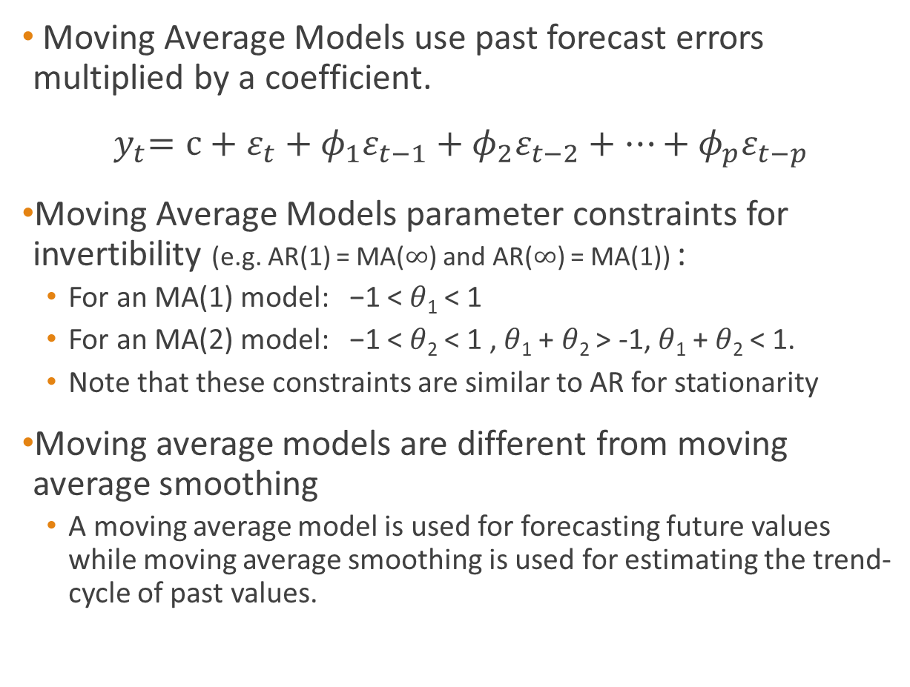
Moving Average Models
Moving Average Models use past forecast errors multiplied by a coefficient.
$${ y}_{t}=c+ε_{t}+{φ_{1}ε}_{t−1}+{φ_{2}ε}_{t−2}+…+{φ_{p}ε}_{t−p}$$
Moving Average Models parameter constraints for invertibility (e.g. AR(1) = MA($∞$) and AR($∞$) = MA(1)) :
For an MA(1) model: −1 < 𝜃₁ < 1
For an MA(2) model: −1 < 𝜃₂ < 1 , 𝜃₁ + 𝜃₂ > -1, 𝜃₁ + 𝜃₂ < 1.
Note that these constraints are similar to AR for stationarity
Moving average models are different from moving average smoothing
A moving average model is used for forecasting future values while moving average smoothing is used for estimating the trend-cycle of past values.

Slide 11


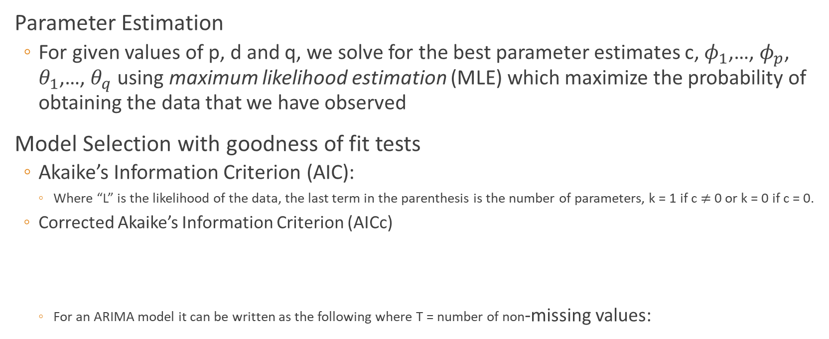
Parameter Estimation and Model Selection
Parameter Estimation
For given values of p, d and q, we solve for the best parameter estimates c, $φ_{1}$,…, $φ_{p}$, $θ_{1}$,…, $θ_{q}$ using maximum likelihood estimation (MLE) which maximize the probability of obtaining the data that we have observed
Model Selection with goodness of fit tests
Akaike’s Information Criterion (AIC):
Where “L” is the likelihood of the data, the last term in the parenthesis is the number of parameters, k = 1 if c $≠$ 0 or k = 0 if c = 0.
Corrected Akaike’s Information Criterion (AICc)
For an ARIMA model it can be written as the following where T = number of non-missing values:
Notes:
Add explanation for K and T

Slide 12
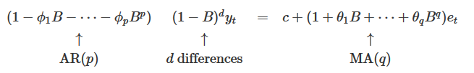
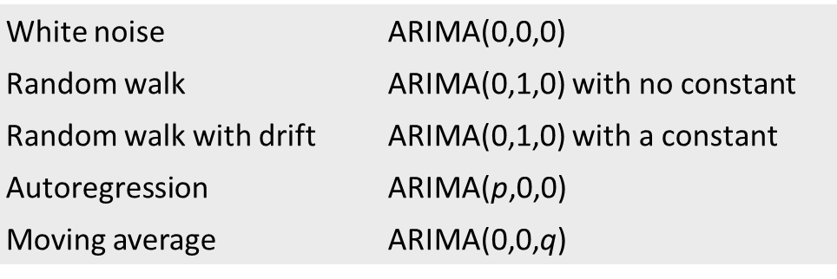
Non-seasonal ARIMA Model Review
Final Model :
Special ARIMA model types from our textbook:
Be mindful that in a mixed ARIMA Model (where p and q are positive) AR and MA terms can potentially cancel out the effects of each other.

Slide 13
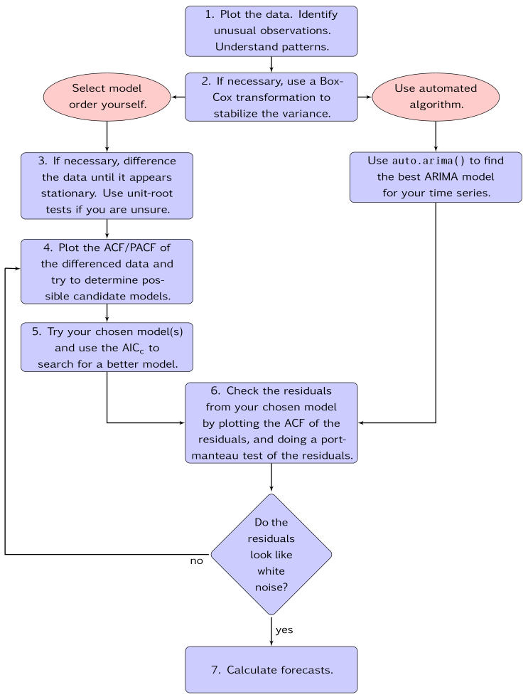
ARIMA MODELING JOB AID

Slide 14
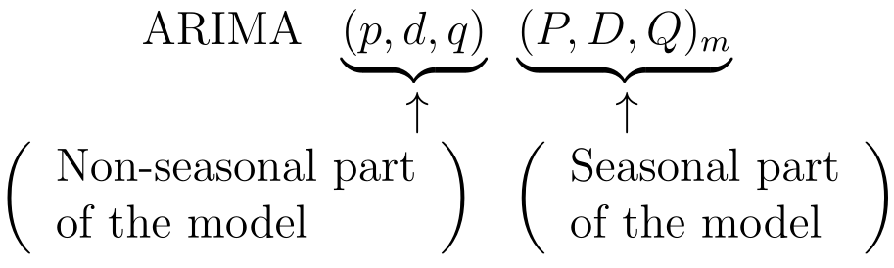
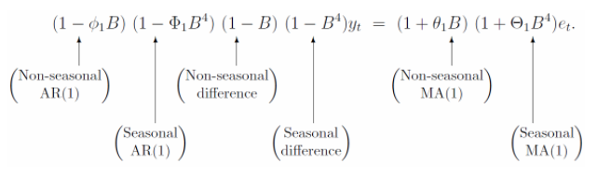
Seasonal ARIMA models
In the example from Forecasting: Principles and Practice, an ARIMA(1,1,1)(1,1,1)₄ model (without a constant) for quarterly data (m=4) and can be written as:
Seasonal ARIMA Model
Notes:
Further explain

